Slide 1
To Redux or Not
to Redux?
Medhat Dawoud
11 April 2020 🎂

Slide 2
I’m Medhat Dawoud
👨‍💻 Sr. Frontend Engineer with over a decade of experience.
📢 Public speaker and tutor for long time.
⌨️ Open source contributor on github.
▶️ Making FREE tech videos on YouTube (SemiColon Academy)
💻 Published a premium course with Packt 2019 (Redux Recipes)
You could easily contact me on twitter @med7atdawoud
as I don’t have Facebook 😎

Slide 3
Who should watch this session?
💻 Experienced React developers who have doubts about using Redux in a new project.
👨‍💻 People who has concerns about Redux after hooks.
😉 Anyone interested in state management.

Slide 4
What does this session answer:
1️⃣ why would you need state management?
2️⃣ what are the available solutions?
3️⃣ why you should use redux?
4️⃣ when you should NOT use redux?

Slide 5
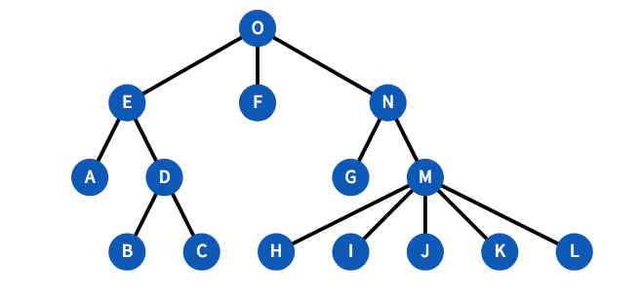
What is the need for state management system?

Slide 6
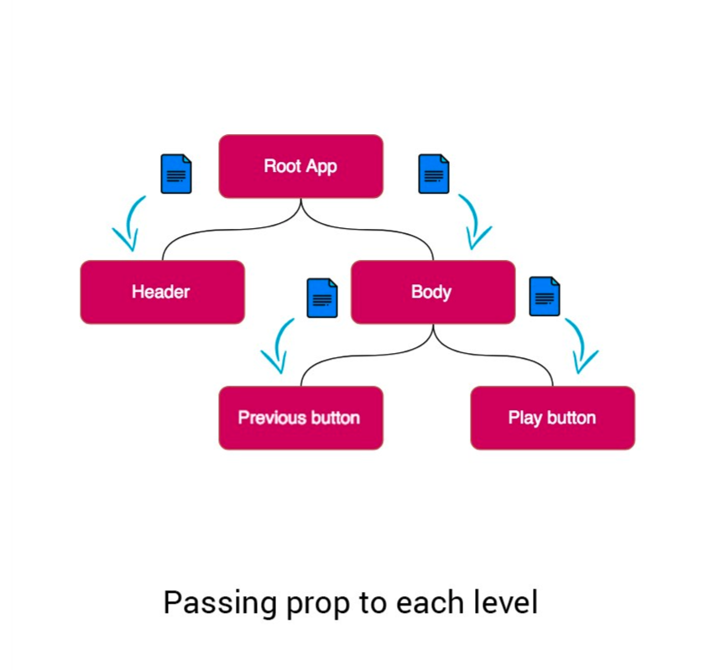

Options available of state management:
Prop drilling (native)

Slide 7
Options available of state management:
Redux lib 🎉
It has some steep learning curve but okay ✔
Will be explained later today

Slide 8
Options available of state management:
Context APIs (native 16.3)
It was very bad and hard in syntax until hooks came to the game
Also, lakes for some features like debugging tools or middlewares

Slide 9
Options available of state management:
Other Redux like libs
(mobX, apollo-link, .. etc)
Good but not better than Redux IMO

Slide 10
So, How Redux resolve
this problem?

Slide 11
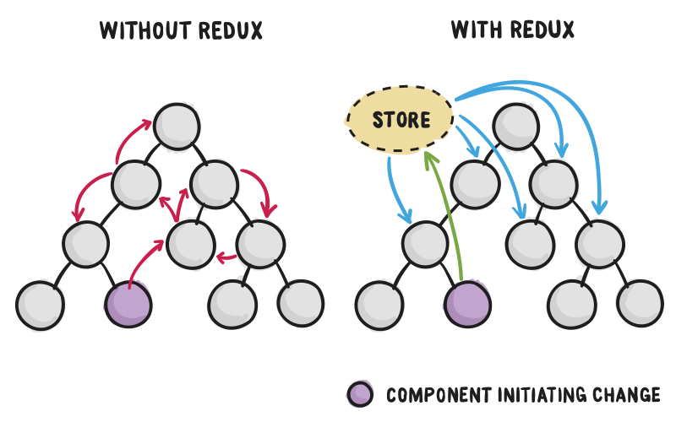
How Redux works?

Slide 12
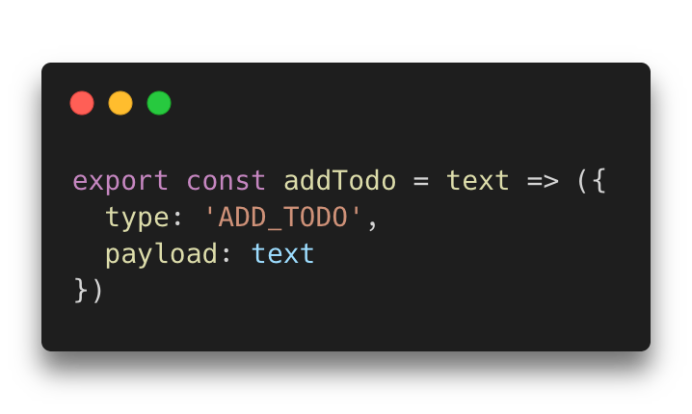
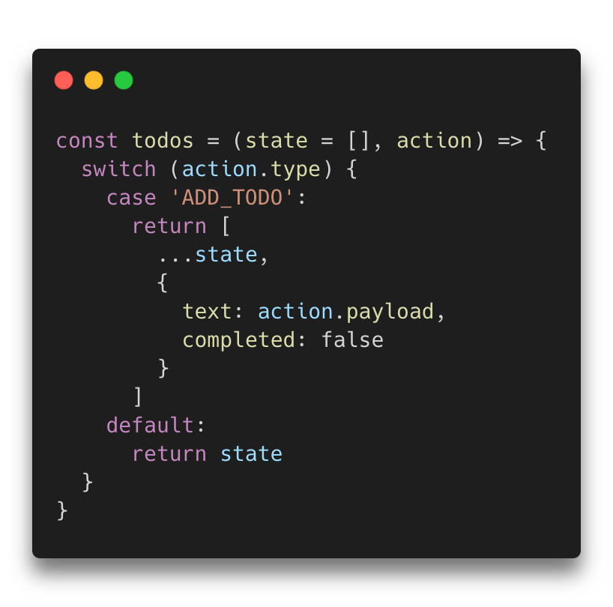
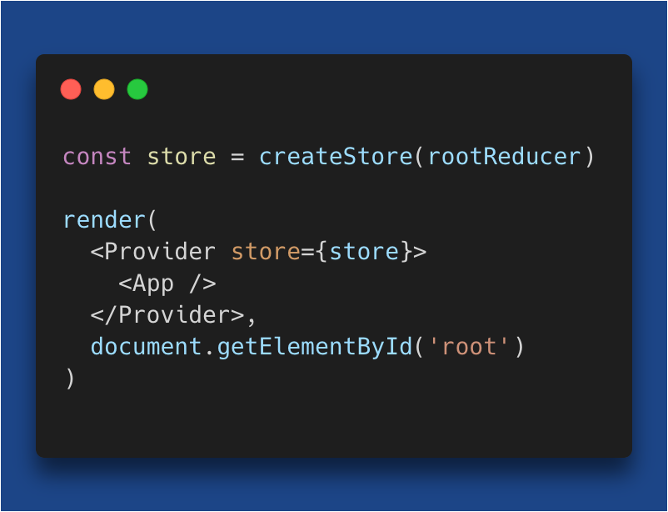
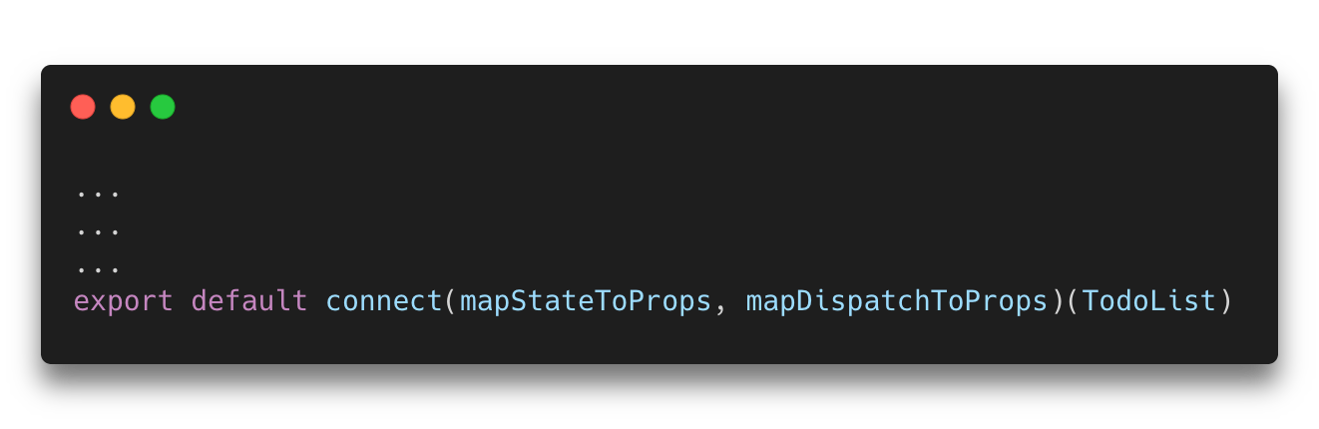
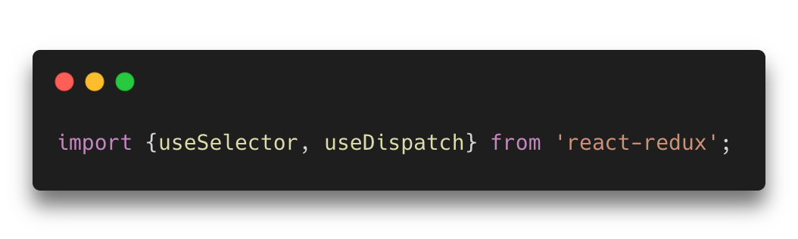
How Redux works?
├── src
│ ├── actions
│ ├── components
│ ├── containers
│ ├── reducers
│ ├── screens
│ ├── store
│ └── themes
├── package.json
├── App.js
├── src
│ ├── actions
│ ├── components
│ ├── containers
│ ├── reducers
│ ├── screens
│ ├── store
│ └── themes
├── package.json
├── App.js

Slide 13
So, why you might need Redux?

Slide 14
Why you might need Redux?
Separation of concerns

Slide 15
Why you might need Redux?
Predictability

Slide 16
Why you might need Redux?
Ease of testing

Slide 17
Why you might need Redux?
Community Support

Slide 18
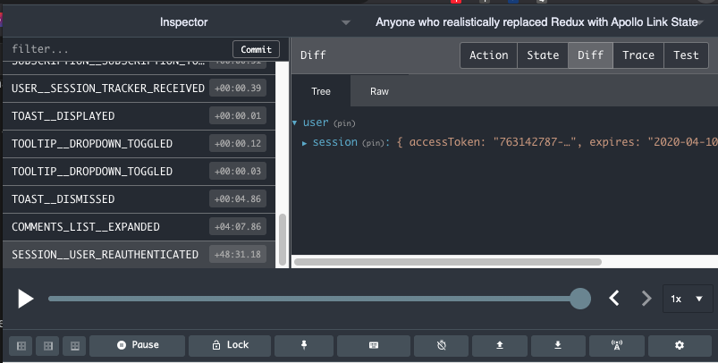
Why you might need Redux?
Browser DevTools

Slide 19
Why you might need Redux?
Modern and has its own custom hooks
(useSelector, useDispatch)

Slide 20
Why you might need Redux?
React recommends it
Even created the new hook useReducer inspired from
Redux with almost same syntax

Slide 21
when you might
NOT
need Redux?

Slide 22
when you might NOT need Redux?
Application is not complex enough for it

Slide 23
when you might NOT need Redux?
Shared changes are not very big and could be native easier

Slide 24
when you might NOT need Redux?
Your team hates boilerplate code

Slide 25
when you might NOT need Redux?
You would like to stay away from third parties
Smaller bundles

Slide 26
when you might NOT need Redux?
If you have no problem with Context API + Hooks

Slide 27
when you might NOT need Redux?
If you are using GraphQL and would like to use apollo-link

Slide 28
Conclusions

Slide 29
Conclusions
Redux is a great tool for managing state in react apps
maybe still the best

Slide 30
Conclusions
Understand the cost of adding redux before starting

Slide 31
Conclusions
Redux is an architecture not a lib

Slide 32
Conclusions
if you trade something off, make sure you get something in return

Slide 33
Conclusions
Nothing is always best or perfect, try everything and decide yourself 😉

Slide 34
Conclusions
Now you could hopefully decide
to Redux or not to Redux
in your next project

Slide 36





Thanks for watching
Find me online 👇
@med7atdawoud
🌐 medhatdawoud.net
/SemicolonAcademy
/SemicolonAcademy
/medhatdawoud

